Slide 1
Object-oriented Programming
Week 1 | Lecture 2

Slide 2
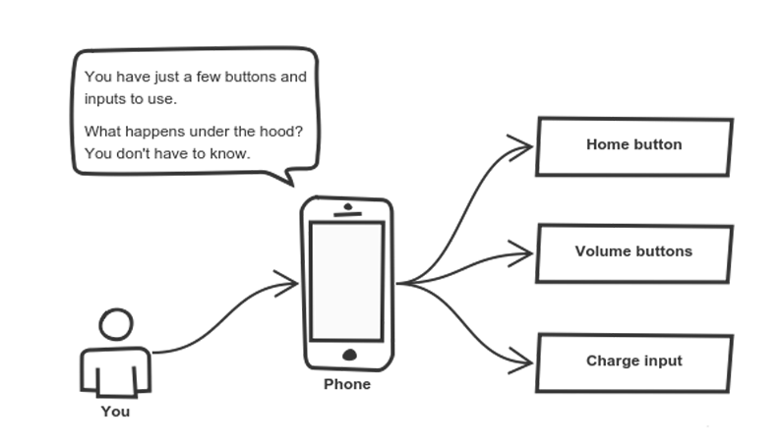
Recap

Slide 3
Information Hiding
Implementation details are hidden from the outside world
Information is stored within the object
It can only be changed by the object itself

Slide 4

Example: Smartphone
All logic is hidden inside the handset
You use HOME button to get to the home screen without knowing “how” it was done

Slide 5
Advantages of Information Hiding
Simplifies the model by hiding implementation details
Prevents accidental access
Prevents illegal access or manipulation

Slide 6

Classes
Accelerator Pedal
Brake Pedal
Steering Wheel
User-friendly “interfaces” to control the car
Their mechanism is housed inside the engineering drawings or blueprints

Slide 7
Classes
class Car
{
void accelerate() { \\ logic for acceleration }
void brake() { \\ logic for brakes }
};

Slide 8
Classes
class Car
{
string model; int numOfDoors; string color;
void accelerate() { \\ logic for acceleration }
void brake() { \\ logic for brakes }
};

Slide 9
How to use the car?
int main()
{ Car mycar; car.accelerate();
}

Slide 10
Class vs Struct
Members of a class are private by default and members of struct are public by default
Classes can be inherited whereas structures cannot
Struct are value-type whereas classes are reference-type
A structure can't be abstract, a class can be

Slide 11

Problem
int main()
{ Car mycar; car.accelerate();
}
The function accelerate() cannot be accessed!

